Slide 1
🏦 Loan Prediction Analysis
Machine Learning Approach to Credit Approval Prediction
AI And Data Science group 6 Project
Comparing Logistic Regression vs Decision Tree Models

Slide 2
📋 Project Overview
Objective
Develop a machine learning model to predict loan approval status based on applicant characteristics and financial information.
Dataset
Source: Loan_train.csv
Features: Demographics, Income, Credit History
Target: Loan_Status (Approved/Rejected)
Methodology
Exploratory Data Analysis
Data Cleaning & Preprocessing
Feature Engineering
Model Training & Evaluation
Performance Comparison
Models Used:
Logistic Regression & Decision Tree Classifier

Slide 3
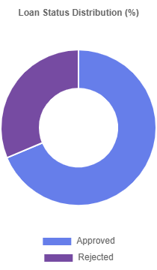
📊 Dataset Overview
Features Analyzed
Demographics: Gender, Married, Education
Financial: Applicant Income, Coapplicant Income
Loan Details: Loan Amount, Loan_Amount_Term
Other: Credit_History, Property_Area, Self_Employed
Data Quality Issues
Missing values in multiple columns
Categorical data requiring encoding
Different scales across features

Slide 4
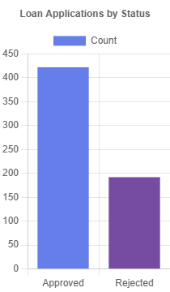
🎯 Target Variable Analysis
Loan Status Distribution
Understanding the class balance in our dataset is crucial for model performance evaluation.
Implications
Model might be biased toward majority class
Precision and Recall become important metrics
F1-score provides balanced evaluation
Key Insight: The dataset shows a higher proportion of approved loans compared to rejected ones, indicating potential class imbalance that needs to be considered during model training.

Slide 5
🔧 Data Preprocessing Pipeline
Missing Value Treatment
# Categorical features: Mode imputation df['Gender'].fillna(df['Gender'].mode()[0], inplace=True) df['Married'].fillna(df['Married'].mode()[0], inplace=True) # Numerical features: Mean imputation df['LoanAmount'].fillna(df['LoanAmount'].mean(), inplace=True)
2. Feature Engineering
Convert "3+" dependents to numeric (3)
Label encoding for categorical variables
Standard scaling for numerical features
3. Data Split
80% Training data
20% Testing data
Stratified sampling maintained

Slide 6
🤖 Model Training & Architecture
Logistic Regression
Type: Linear Classification
Assumption: Linear decision boundary
Interpretability: High
Complexity: Low
Decision Tree Classifier
Type: Tree-based Classification
Assumption: Non-linear patterns
Interpretability: Medium
Complexity: Medium
lr = LogisticRegression() lr.fit(X_train, y_train)
dt = DecisionTreeClassifier(random_state=42) dt.fit(X_train, y_train
Why These Models?
Both models provide good interpretability for business stakeholders while offering different approaches to classification - linear vs tree-based decision making.

Slide 7
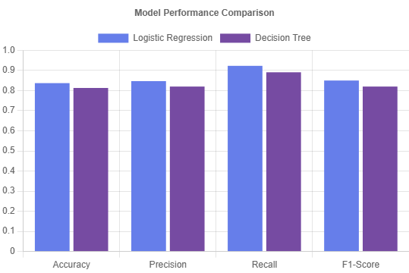
📈 Model Performance Comparison
83.7% LR Accuracy
81.3%
DT Accuracy
Key Finding: Logistic Regression outperforms Decision Tree across all metrics, suggesting that the relationship between features and loan approval is more linear than complex.
0.85
LR F1-Score
0.82
DT F1-Score

Slide 8
🔍 Feature Importance Analysis
Most Important Features (Decision Tree)
Credit_History 0.85 ApplicantIncome 0.45
LoanAmount 0.35 Property_Area 0.25
Education 0.15
Business Insights
Credit History is the dominant factor
Applicant Income significantly impacts approval
Loan Amount affects risk assessment
Property Area influences regional policies
Recommendation: Focus on credit history verification and income assessment for loan approval decisions

Slide 9
📋 Detailed Performance Metrics
LOGISTIC REGRESSION
DECISION TREE
0.845 Precision
0.820
Precision
0.923
Recall
0.891
Recall
CONFUSION MATRIX
Predicted: No Yes Actual: No [[15 8] Yes [ 9 101]
CONFUSION MATRIX
Predicted: No Yes Actual: No [[12 11] Yes [12 98]]
Analysis:
Logistic Regression shows better precision and fewer false positives, making it more suitable for loan approval where conservative decisions are preferred.

Slide 10
🎯 Conclusions & Recommendations
Key Findings
Logistic Regression outperformed Decision Tree
Credit History is the most important predictor
Model achieves 83.7% accuracy
Linear relationships dominate the dataset
Business Recommendations
Implement Logistic Regression for production
Prioritize credit history verification
Consider income-to-loan ratio thresholds
Regular model retraining with new data
Next Steps
Feature engineering for better performance
Cross-validation for robust evaluation
Ensemble methods exploration
Real-world deployment testing
THANKYOU!
Impact: This model can help financial institutions make more informed, consistent, and faster loan approval decisions while reducing manual processing time

